Slide 1


Implementing Local School Governance and Maximizing Flexibility in Georgia Charter School Systems
Charter System Foundation Governance Training 2019-2020

Slide 2
Agenda Topics
What is a Charter System?
What is Effective Governance for Charter Systems?
What is Broad Flexibility?
What are examples of Broad Flexibility in Charter Systems?

Slide 3
Agenda Topic #1
What is Effective Governance for Charter Systems?

Slide 4
What is Governance?
A charter system must
maximize school level governance and the involvement of parents, teachers, and community members in such governance
grant decision-making authority in personnel decisions, financial decisions, curriculum and instruction, resource allocation, establishing and monitoring the achievement of school improvement goals, and school operations
per O.C.G.A. 20-2-2062 and 20-2-2063

Slide 5
What is Governance?
Georgia law makes it clear that schools within gadoe.org a charter system remain under the control and management of the Local Board of Education
[See O.C.G.A. 20-2-2065(b)(2)]
• This means that, although the Superintendent and LBOE must give consideration to the recommendations and input of LSGTs, the LBOE ultimately retains its constitutional authority

Slide 6
46 Charter Systems in Georgia*
(1 of 3)
Atlanta Public Schools first year: 2016 end 2021
Banks County Schools first year: 2013 renewed 5 years end 2023
Baldwin County Schools first year: 2016 end 2021
Barrow County Schools first year: 2011 renewed 10 years end 2026
Ben Hill County Schools first year: 2018 end 2023
Calhoun City Schools first year: 2011 renewed 10 years end 2026
Candler County Schools first year: 2015 end 2020
Carrollton City Schools first year: 2014 end 2020
Cartersville City Schools first year: 2010 renewed 10 years end 2025
Catoosa County Schools first year: 2016 end 2021
City Schools of Decatur first year: 2008 renewed 10 years end 2023
Clarke County Schools first year: 2016 end 2021
Coffee County Schools first year: 2013 renewed 5 years end 2023
Colquitt County Schools first year: 2015 end 2020
Commerce City Schools first year: 2014 end 2019
Dawson County Schools first year: 2010 renewed 10 years end 2026
Dougherty County Schools first year: 2016 end 2021
Dublin City Schools first year: 2011 renewed 5 years end 2023
Evans County Schools First year:2019 end 2024
Fannin County Schools first year: 2015 end 2019
Floyd County Schools first year: 2010 renewed 5 years end 2021

Slide 7
46 Charter Systems in Georgia*
(2 of 3)
22. Fulton County Schools first year: 2012 renewed 5 years end 2020
23. Gainesville City Schools first year: 2008 renewed 10 years end 2023
24. Gilmer County Schools first year: 2014 end 2024
25. Glascock County Schools first year: 2014 end 2019
26. Gordon County Schools first year: 2011 renewed 5 years end 2026
27. Haralson County Schools first year: 2013 renewed 5 years end 2023
28. Hart County Schools first year: 2014 end 2019
29. Jasper County Schools first year: 2016 end 2021
30. Lumpkin County Schools first year: 2014 end 2020
31. Liberty County Schools first year: 2015 end 2020
32. Madison County Schools first year: 2012 renewed 5 years end 2022
33. Marietta City Schools first year: 2008 renewed 10 years end 2023
34. Morgan County Schools first year: 2011 renewed 10 years end 2026
35. Peach County Schools first year: 2016 end 2021
36. Pelham City Schools first year: 2018 end 2023
37. Putnam County Schools first year: 2010 renewed 10 years end 2025
38. Randolph County Schools first year: 2016 end 2021
39. Stephens County Schools first year: 2014 end 2021
40. Taliaferro County Schools first year: 2018 end 2022
41. Terrell County Schools first year: 2016 end 2021

Slide 8
46 Charter Systems in Georgia*
(3 of 3)
42. Tift County Schools first year: 2016 end 2021
43. Union County Schools first year: 2014 end 2024
44. Vidalia City Schools first year: 2014 end 2024
45. Warren County Schools first year: 2008 renewed 5 years end 2022
46. White County Schools first year: 2010 renewed 10 years end 2025
  * Performance Contracts Ending dates may vary from the original contract’s cycle due to some charter systems’ alignment of contract renewal with Accreditation Visits, College and Career Academy Certification visits, or extenuating circumstances that warrant an extension to the performance contract.

Slide 9

General
Governance Team Responsibilities
Adopt the school improvement plan and updates
Review progress on the school improvement plan
Participates in the identification of instructional programs, operational processes, resources and innovations to improve student achievement
Provide input into the annual school budget and may approve
Participate in hiring of the Principal in the case of a vacancy, and may have input into performance goals and provide feedback on the performance of the Principal

Slide 10

Code of Ethics/Conduct
Respect chain of command
Do not provide direction to staff or influence staffing decisions unless officially designated to be part of the selection process
Represent all students
Be informed about matters before the Governance Team
  Focus on facts related to student achievement
Communicate community issues to the principal
Participate in training and attend meetings
Work collaboratively with others
Speak with one voice
Individual LSGT members have no authority
Mandatory child abuse reporter

Slide 11
Charter System Governance Structure
LSGT
LBOE
Superintendent
Principal
School staff
Determines district budget
Approves personnel
Recommends to Superintendent and Board
Provides input into and may approve school budget
Provides input into and may approve school personnel positions and allocations
Principal candidate in the case of a vacancy (may be as part of a larger process)
Develops district budget
Selects and directs
district personnel
Develops school budget
Recommends, manages and evaluates school personnel
Instructs and supports students

Slide 12

Local School Governance Team Authority and Decision-Making
Establishing & Monitoring the Achievement of School Improvement Goals
Best Practices
Some LSGT members serve as members of the school improvement planning team
Recommends innovations requiring waiver to state law to superintendent
Receives information and provides input to principal on school improvement plan implementation
Recommends school improvement plan to superintendent

Slide 13

Local School Governance Team Authority
Personnel Decisions
Best Practices
Recommends principal candidate to superintendent in the case of vacancy
Provides input to principal on desired characteristics for new or vacant non-teaching positions or innovative new teaching positions
Provides input to superintendent on principal performance via a structured questionnaire
LSGT representatives provide input on administrative hires via participation in candidate screening and/or interview panels

Slide 14

Local School Governance Team Authority
Financial Decisions and Resource Allocation
Best Practices
Recommends school general fund budget aligned with the school improvement plan to the superintendent
Provides Input to principal on use of Title 1 budget, and may endorse with a vote
Decides use of school-generated funds
Collaborative process to provide input to related-organizations regarding use of funds (Foundations, PTAs, Boosters)
Recommends use of SPLOST technology funds
Decides use of Charter System funds allocated to the school, aligned with school improvement plan

Slide 15


Local School Governance Team Authority
Curriculum & Instruction
Best Practices
Recommends new courses and subjects to the superintendent
Provides input to the principal regarding instructional resources aligned with the school improvement plan
Provides input to the principal regarding instructional delivery models not requiring waivers
Recommends innovations requiring waiver or state laws or rules to the superintendent
Recommends class sizes other than the district standard to the superintendent
Recommends changes in allocation of instructional time to the superintendent

Slide 16
Local School Governance Team Authority
School Operations
Examples of Authority
Decides student dress code
Provides input to principal on student code of conduct, and may endorse with a vote
Provides input on school safety plan to principal or superintendent, and may endorse with a vote
Recommends changes to school calendar or start/end times to the superintendent
Decides on community partners offering programs in the school
Provides input to superintendent on facility improvements
Provides input on other operational matters aligned with the school improvement plan
Provides input into parent involvement strategies
Recommends a school technology plan to the superintendent

Slide 17
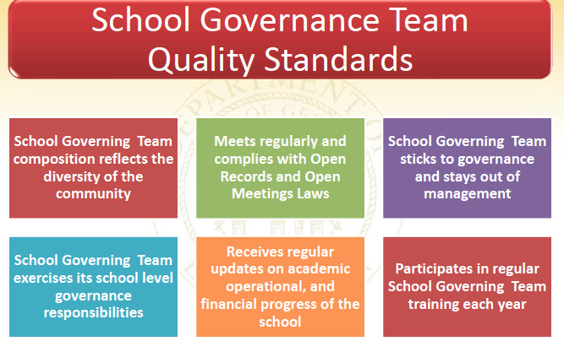
Quality School Governance in a Charter System
Source: Georgia Department of Education

Slide 18
The Work of LSGTs
Charter System Testimonials
Calhoun City: "School Governance Teams are invaluable to the success of our charter system. The collective wisdom of this diverse group of stakeholders definitely helps us to be more innovative. SGTs work together to continuously improve or schools to best meet the learning needs of our student and the workforce needs of our community.”
Candler County: "Our SGTs are incubators that foster the development of innovative and flexible initiatives that allow us to better prepare students for the future success.”
Barrow County: “SGT's are an integral part of the cohesive communities, instructional vision, operational efficiency and success of Barrow County Schools. Barrow’s Center for Innovative Teaching through a district-wide partnership with ArtsNow is an example of the successful use of innovative teaching practices and flexibility in collaboration with our SGTs.”
Fannin County:
  “One of our countywide innovative practices is STEM/STEAM education. I truly do not feel that West Fannin Elementary would have been able to obtain GaDOE STEM Certification as successfully or efficiently without the support, advice, and creativity of our School Governance Team."
  "The brainstorming sessions that occur during our SGT meetings cannot be replicated or rehearsed. The creative ideas that come out of our SGT meetings are invaluable and will help us accomplish our future goals such as GaDOE STEAM Certification."

Slide 19
Agenda Topic #2
What is Broad Flexibility?

Slide 20
Broad Flexibility
Broad Flexibility is the Freedom Granted to Charter Systems that allows them to waive most of OCGA Title20, and State Board of Education Rules/Guidelines
Broad Flexibility is intended to be used in designing and implementing innovations that will advance student achievement and support the school improvement plan and district strategic plan.

Slide 21
What Laws Are NOT Included in Broad Flexibility?
All Federal Laws
Federal, state, and local laws/rules/guidelines re:
Civil rights,
Insurance,
Protection of the physical health and safety of school students, staff and visitors
Conflicts of interest
Prevention of unlawful conduct in or near a public school
Reporting requirements
Accountability

Slide 22
What Laws are Included in Broad Flexibility?
Everything Else in Title 20 and SBOE rules/guidelines
Most common uses of Broad Flexibility (Waiver of Laws):
  How Instructional Time is Used
  How the School Day and Year are Structured
  How the School is Staffed, including Certification, Compensation Models, and Class Sizes
  How Federal, State and Local Funds are Used to Support the School Improvement Plan (Consolidated Funds)
  How Instruction is Delivered, Who Delivers the Instruction, and Where it is Delivered
  How Support Services are Provided
  What is Taught in Addition to the State Curriculum (Georgia Standards of Excellence)

Slide 23
Broad Flexibility Facts Vs. Myths
A Charter System does NOT have to ask the state for permission each time it exercises its broad flexibility.
Charter Flexibility does NOT mean that a charter system is free from all federal laws.
The use of flexibility does NOT have to look the same in all charter systems, or even in all schools within a charter system.
A Charter System DOES needs to align the use of waivers with the District’s System Strategic Plan and the School Improvement Plan
Flexibility SHOULD BE used to implement innovations that support improve overall improvement of student achievement.
School Governance Teams SHOULD have input into the development and implementation of innovations to improve student achievement.
A charter system CAN exercise its use of waivers as the need to address challenges arises.

Slide 24
Examples of Charter System Waivers-
Academic Program
Staffing, Class Size, Program Delivery Example:
  Challenge: An elementary school has several students who do not meet program criteria for gifted or REP programs but who can benefit from services provided by teachers in those classrooms. The specific program delivery models described in Georgia law are getting in the way of the school begin able to better meet their students’ needs
  SBOE Rule:160-4-2.38, 160-4-2-.17
  Solution: Students served by need, not label. School determines gifted delivery model based on student needs. Advanced students served in Gifted class. Students in need of remediation placed in REP classes. Both classes exceed the state’s maximum class size. No more funding available, but more students served.

Slide 25
Examples of Charter System Waivers-
Academic Program
Alternative/Non-Traditional Education Programs, 20 Additional Day Funds, Health and Physical Education Rule
    Challenge: School needs an alternative education program that meets student needs and aligns with system strategic improvement plan and students’ needs. Programs specified in state law are not meeting students’ needs.
    OCGA § 20-2-154.1; 20-2-240; 20-2-300; 20-2-184.1, 160-4-2-.12
    Solution: Design a grades 5-12 program that provides opportunities for remediation, acceleration, credit recovery, and offers non-traditional pathways to a high school diploma and/or a technical college certificate

Slide 26
Examples of Charter System Waivers-
Academic Program
Retention Requirements
    Challenge: Ga law and SBOE rule base promotion/retention in specific grades on one test score. School’s Data Teams and RTI teams have determined that that many of the students just need additional time and resources to achieve academic success in some, but not all, academic areas. School wants to base P/R on totality of info and not one test score and serve students in the areas in which they are not achieving mastery.
    SBOE Rule:160-4-2.11
    Solution: Students receive instruction based on their needs and not their grade level designation. Instruction continues until students demonstrate content mastery.

Slide 27
Examples of Charter System Waivers-
Human Resources
Certification
  Challenge #1: CCA business partners have advised that students in several career pathways could benefit from the expertise provided by practitioners as instructors. State law requires teachers to have a teaching certificate.
  Solution #1: Hire RN to teach Anatomy and Physiology; Contract with a local chef to teach Culinary Arts
  Challenge #2: Small rural community cannot find a certified art teacher for the elementary school
  Solution #2: Hire a local artist to teach part-time or full-time and provide art instruction in grades K-5.
  OCGA 20-2-108, 20-2-200

Slide 28
Examples of Charter System Waivers-
Human Resources
Class Size and Staffing Requirements
  Challenge: In an elementary school, many classes exceed state max class size well into the year as new students move in. SGT has determined that the school is not maximizing use of personnel to meet SIP goals
  SBOE Rule: 160-5-1
  Solution: Kindergarten class with 22 students and para-pro has additional student enroll in December. No need to split class and hire additional teacher
  Solution: State requires a full time media specialist. SGT recommends having ½ time Media Specialist and ½ Math Coach to meet SIP goals in math. Could be the same person, 2 people sharing these positions, or 2 people working PT. No additional personnel required.

Slide 29
Examples of Charter System Waivers-
Human Resources
Salary Schedule Requirements
    Challenge: School system has a variety of personnel needs for positions that do not fit into the state salary schedule. System wants to strengthen state salary schedule for increased compensation in critical, high need areas
    OCGA 20-2-212
    Solution: Hire RN to teach Healthcare Science course and adjust salary to be competitive with healthcare industry; Build a Pay for Performance grants program for teachers; Contract with 49% staff at set hourly rate and maximize personnel allocations

Slide 30
Examples of Charter System Waivers-
Financial Flexibility
Categorical Allotment Requirements and Direct Classroom Expenditures
    Challenge: School and system budgets are not based on system strategic improvement plan and students’ needs. Based instead on how GA law specifies how funds must be spent
    OCGA 20-2-183, 20-2-167, 20-2-171
    Solution: Expend funds in area of professional development related to a particular goal and area of need in the strategic plan (i.e., math achievement, working with EL population); Use state funding marked for remediation instruction to provide transportation to summer remediation classes

Slide 31
Examples of Charter System Waivers-
Financial Flexibility
Consolidated Funds
Federal law allows districts to consolidate federal funds (Title 1,2,3, Special Education, etc.) with state and local funds into a single pool of funds to support a schoolwide program
Federal funds lose their identity and are treated as state and local funds
School no longer has Title I teachers with restrictions on what they can do; equipment purchases funded through the consolidated pool are not treated as federal property
Consolidated schoolwide budget becomes one line item, except for mandated federal set asides
Started as a pilot. GA in 5th year of implementation of consolidated funds project districts (36 districts FY20)
Districts reporting significant benefits from the increased flexibility
    Contact: Shaun Owens at sowens@doe.k12.ga.us

Slide 32
Examples of Charter System Waivers-
Financial Flexibility
Charter System QBE Funds
Charter System Funding is included in the QBE allotment and can be carried over from year to year.
Districts have flexibility over the charter system funding
Funding must be used to implement innovations, support the school and/or district improvement plans and training/support School Governance Teams, school and district staff and leadership in the work of effective charter systems.

Slide 33
Examples of Charter System Waivers-
Operations
  School day and school year for students and employees.
    Challenge: Middle school calendar and school day schedule are not meeting student needs for strategic areas, such as career exploration, social emotional support services and programs
    O.C.G.A. § 20-2-151, 20-2-160, 20-2-161.1, 20-2-165, 20-2-168, 20-2- 168(c), 20-2-240.
    Solution: Create opportunities for career exploration in Grades 6-8 by restructuring the school day to allow for a full day of career exploration at given intervals during the school year (monthly, quarterly, etc.) and added opportunities for students to have social emotional support services and programs

Slide 34
Agenda Topic #3
What are Examples of Broad Flexibility in Charter Systems?

Slide 35
Calhoun City Schools
Captures Kids’ Hearts – Social Emotional Well-Being
The Challenge: Calhoun City Schools wanted to continue to provide classroom and school environments to inspire all students to be lifelong learners in the pursuit of excellence... to win their hearts and to lead them to their personal best.
The Innovation - Focus on school climate and culture to build stronger relationships with teachers, students and families. Social Emotional Learning.
LSGT involvement: School Governance Teams supported the use of consolidated funds to support the initiative.
Flexibility Used: Consolidation of Funds- local, state and federal funds were used to support the initiative to pay for professional learning and support of Teacher / Leader Development Specialist
Results:
  Improved behavior and attendance have resulted. More students are engaged in extracurricular opportunities.
Contact: Kelli Kendrick, Chief Acad Off. kendrickk@calhounschools.org

Slide 36
Cartersville City Schools
Taking on a Threat to Student Health & Safety
Challenge: Increase in student use of e-cigarettes/vaping
Innovation:
  Governance Teams taking on the challenge - Discussion phase began and community conversations will start in new school year
Stay tuned for next steps
  Flexibility:
  Results:

Slide 37
“Charter Flexibility in Action”
Dawson County Schools -Realignment of Grades 6-12
Challenge: Five years ago, Dawson County Schools had two very small middle schools that fed into a single high school. Needed to better utilize personnel/human resources to increase accelerated course offerings to challenge most capable 8th gr. students AND create opportunities for their most fragile 8th graders to get a head start on graduation by earning high school credit early. Meeting both these needs would lead to higher graduation rates and students being better prepared for college and careers.
The Innovation: The realignment occurred in two phases. Fall 2016, all 6th and 7th graders placed together in one of the existing middle schools. The other middle school became Dawson County Junior High and served only 8th grade students during Phase I. Phase II Fall of 2017, ninth grade students moved to the junior high. Upon completion, the middle school serves grades 6/7. Dawson County Junior High now serves grades 8/9. Grades 10-12 make up the high school.

Slide 38
Dawson County Schools -Realignment of Grades 6-12
System Governance Team: The System Governance Team was used extensively throughout both phases of the realignment. Many meetings were held with Local School Governance Teams to gather input and plan for each step of the process. The decision to do a two year phase in plan was based on the recommendation of the governance teams.
Flexibility Used:- The district waived the middle school program criteria to accomplish the realignment of grades 6-12. (160-4-2-.05 MIDDLE SCHOOL PROGRAM CRITERIA)
Results:
  Having students grouped by these age levels has provided positive social benefits to students which impacts school climate.
  The district has increased the number of opportunities for 8th grade students to take accelerated classes and earn high school credits in both academic and elective courses.
  The district has achieved a three year average graduation rate of 95%.
Contact: Dr. Damon Gibbs, Superintendent of Schools www.dawsoncountyschools.org 706-265-1226

Slide 39

“Charter Flexibility in Action”
Calhoun City Schools –Jacket Junction Mobile Learning Lab – Crayons to Careers
Challenge: Students were not ready for pre-K and lacked simple vocabulary and readiness skills.
Innovation:
  Utilize student instructors from Calhoun's College and Career Academy Teaching as a Pathway and Early Childhood Pathway to provide individual / small group interaction with children 6 months to four years.
  Engages parents and children in the learning process
Travel to local housing authority properties and a local daycare partner.
LSGT Involvement: The LSGT approved use of Charter System funds to support this initiative AND the initiative and curriculum delivery for ECE pathway.

Slide 40
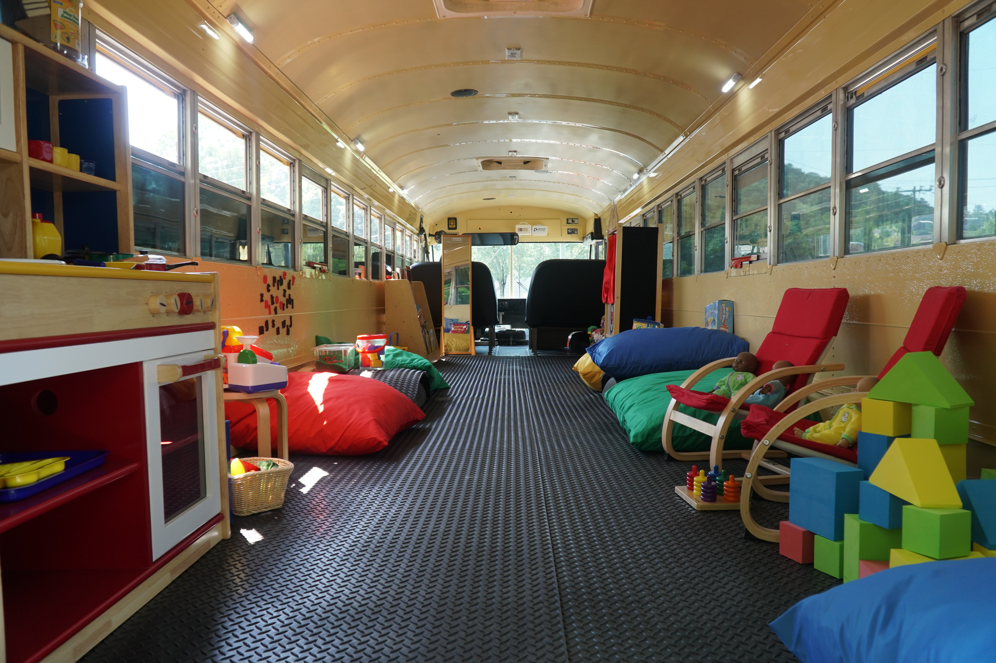

Calhoun City Schools –Jacket Junction Mobile Learning Lab – Crayons to Careers
Flexibility: Seat Time, Scheduling/Time, Delivery of Curriculum, Partnerships
Results:
  CCA students in the ECE and Teaching as a Profession Pathway have gained valuable experiences in setting up classroom centers and lesson planning. They see first hand some of the challenges children have prior to coming to preK and/or kindergarten.
  Regular attendees are benefitting from interactions and skills development. Pre/post assessments show improved readiness skills Data collection is on-going.
Contact: Kelli Kendrick, Chief Academic Officer KendrickK@calhounschools.org

Slide 41
“Charter Flexibility in Action”
Dublin City Schools – Dublin HS Tiny House Poject
Using Charter System Flexibility to hire Industry-Certified experts into teaching roles
Waiving teacher certification in the hiring process
Project teaches variety of CTEA construction
Project utilizes stakeholder partnerships with local land bank, individuals and small businesses in materials acquisitions
Each tiny house is between $7,000-10,000 depending on the fluctuations in raw materials
Finished homes to benefit working poor and families in the City of Dublin. Ribbon Cutting was February 5, 2019.

Slide 42

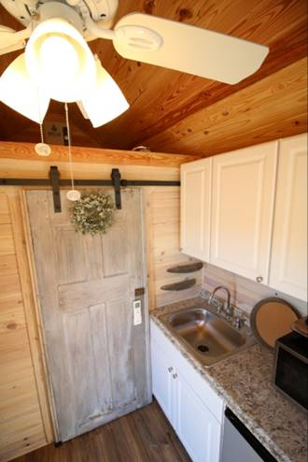


Dublin City Tiny Houses https://youtu.be/qouPH3TyqsA

Slide 43
“Charter Flexibility in Action”
Lumpkin County - Music Industry Pathway
The Challenge: We were looking for something that would give us an opportunity to integrate different areas of STEAM, but would compliment and not compete with our current programs in Fine Arts and CTAE. We also wanted to draw on the rich tradition of musical excellence in Lumpkin County and to utilize the talents of our current staff.
The Challenge: Lumpkin was were looking for something that would provide an opportunity to integrate different areas of STEAM, but would compliment and not compete with our current programs in Fine Arts and CTAE. They also wanted to draw on the rich tradition of the County’s musical excellence and utilize the talents of current staff.
  The Innovation: Creative industries contribute more than $60B to Georgia’s economy each year. An avenue in which students could learn more about opportunities in this field and experience every aspect from playing a guitar to recording an album.
LSGT: The LSGT was not involved until student interest had been determined. At that point, the concept was shared and they were completely on board.

Slide 44
Lumpkin County Schools Music Industry Pathway
Flexibility Used: Lumpkin offers many recognized GaDOE pathways in multiple CTAE areas, but didn't know of an avenue to best utilize the talents of staff to fit the needs and desires of students. Therefore, they used charter flexibility to create their own pathway and best serve our students.
Results:
  Registration numbers for next school year indicate that 243 of the 1156 LCHS students have registered for one of the three courses in the pathway.
  Since formal approval, est. $30,000 worth of equipment donated by former LCHS student and Grammy Award winning artist Zac Brown.
  Working on logistics now and will begin teaching courses in the Fall of 2019.
  Contact: Radford Windham is the creator and driver of this innovation. radford.windham@lumpkinschools.com

Slide 45
“Charter Flexibility in Action” Candler County Schools
“Using Community Experts to Teach a Variety of High Interest Classes”
  Hire local “not certified or qualified” experts to teach certain high interest classes
  Students and community will both benefit.
  Significant savings of funds
  Students now have access to art, music, chorus, dance, computer repair and video production classes. This has expanded to “Growing Our Own Teachers” with Seniors as paid TA’s in the elementary schools.
  Charter funds seeded computer kits and are used to pay for student services.
  Flexibility - Certification
  https://youtu.be/f3JR0AoDGXY
    *Posted on charter System Foundation website

Slide 46
“Charter Flexibility in Action” Atlanta Public Schools - Burgess-Peterson Academy
“Collaborating to Grow Your Community School”
  Competition from Other Schools & Dwindling Enrollment
  The “GoTeam,” created a vision statement for the school and five actions that would enable the vision to become a reality.
  Early Literacy, IB-PYP, Better Outreach to Community
  Strategic Planner is exemplar for APS, leading the district’s work on Orton-Gillingham strategy, significantly improved literacy outcomes (beginning yr 3), enrollment increase 25%.
Flexibility
  Certification
  Scheduling for Instruction
  APS David White BPA Charter System Chat Athens September 2017 * Posted on Charter System Foundation website.

Slide 47
“Charter Flexibility in Action”
Marietta City Extended Year ESOL
Challenge 1: Compounded “summer slide”-Many ESOL students do not speak or hear English or have enriching experiences during the summer break from school.
Challenge 2: More students need to exit ESOL in early grades
Goal: Students who attend summer program will exit ESOL the next school year & will not continue the ”summer slide” in academics and English application
Flexibility: Program scheduling for students and teacher work days; repurpose

Slide 48
“Charter Flexibility in Action”
Marietta City Extended Year ESOL
120 ESOL students (grades 1-3) who scored at similar ACCESS levels and demonstrated potential to benefit the most from the summer program; MAP scores also used
15:1 S/T ratio; teacher has students the next year if possible
Focused academics and ESOL
Transportation, free breakfast and lunch provided
Teachers work 21 days during the summer in exchange for 21 days off during the school year Parenting classes and English instruction for parents; child care for younger and online instruction for older siblings available
56% had increase in MAP scores; overall little or no regression
Potential use: Extended Day, EIP, Gifted, Other…

Slide 49
“Charter Flexibility in Action” Catoosa County School District
Catoosa County Public Schools- “Catoosa U”
  Real-world work experience, high school credit, students paid for internships
  Under direction/supervision of Department that “hired” them
  The Tech Department was the successful pilot for Catoosa U.
  Next steps – Potential Internships: Broadcast Journalism (students will support the elementary news programs); Medical (Certified Nursing Assistant students will work in Catoosa’s Tiger Care School-Based Healthcare Clinic); Education “Grow Your Own Teachers” (Early Childhood Education student interns); Agriscience (Horticulture students will maintain the district’s landscaping).
  Respect and support of business community – next steps toward CCA
  Flexibility:
    Certification (O.C.G.A. 20-2-200)
    SBOE Rule10-4-3-.13 Youth Apprenticeship Programs, 160-4-3-.14 Work Based Learning Programs
    State Board Rules 10-4-3-.13 Youth Apprenticeship Programs and 160-4-3-.14 Work Based Learning Program
    (((
  (

Slide 50
“Charter Flexibility in Action” Georgia DOE
“Career Pathways - From Compliance to Support”
  Support for the development of pathways that better meet the needs of districts, industries and individual students.
  Standards can be merged from 135 pathways/17 career clusters; unique needs of charters such as International Business
  ThinC Academy (Troup) entirely new pathway for local industry needs – 10/17 – SBOE 7/18
  Flexibility – Career Pathways
  CTAE Local Pathway Course Submission Process and the templates: http://www.gadoe.org/Curriculum-Instruction-and-Assessment/CTAE/Pages/Programs-of-Study.aspx

Slide 51
Innovative Assessment Pilot
Milestones-high stakes summative tests; yield lagging data that are not actionable
ESSA invited states to submit applications to pilot innovative assessments to replace current summative assessments
Goal #1: Move to through-year formative/diagnostic assessments that yield actionable data that teachers can use to differentiate instruction. Results would roll up into a summative score that would be used for accountability
Goal #2: Reclaim instructional time lost to Milestones testing
Georgia’s Assessment Pilot (SB 362)-lasts 5 years
Ga DOE invited districts or consortia of districts to submit application to pilot different assessment platforms
3 applications presented and accepted by DOE for the Assessment Pilot.
NAVY, MAP, Cobb
Contact: Dan Weber at dan@charter-system.org; 404-808-6670

Slide 52
For Further Information On Charter Systems
Charter System Foundation
  www.charter-system.org
  Dan Weber - dan@charter-system.org; 404-808-6670
GADOE District Flexibility, Charter Schools, & College/Career Academy Division
  lerste@doe.k12.ga.us
  www.gadoe.org
Dr. Sherrie Gibney-Sherman
  Sherrie.gibneysherman@gmail.com
  706-224-2287
Dr. Emily Lembeck
  EmilyLembeck@icloud.com
  404-316-2576
Dr. Lynn Plunkett
  lplunkett@gmail.com
  706-506-6993

Slide 53
Questions?

